Slide 1

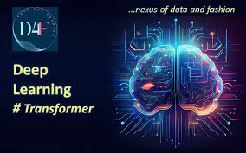

Transformer Prediction on Student Reviews
Tyler Do
CMSC320 Intro to Data Science
12/11/25

Slide 2
The Problem
Students often read written reviews but still rely on numerical ratings to make decisions. Star ratings are subjective and may not align clearly with the tone of the written feedback.
Can a language model accurately predict the ratings a review received using only the text?
Tests if transformer models:
Understand sentiment and nuance in text-based reviews
Map natural language to a discrete, interpretable score
?

Slide 3
Data Collection
Data Collected:
690 total reviews collected
Written student reviews
Star Ratings (1-5)
Professor name
Source: PlanetTerp API (UMD Professor review platform)
Professors Selection:
Justin Wyss-Gallifent
Clyde Kruskal
Aravind Srinivasan
Nelson Padua-Perez
Aubrey Zinn
Final Dataset:
690 total reviews
Written student reviews
Star Ratings (1-5)

Slide 4
Model
Task: Predict a professor review rating (1-5) from review text
Model: GPT-2 fine-tuned for classification
Input: Tokenized student review text
Output: One of the 5 star categories (1-5)
?
!

Slide 5
Approach
Converted star ratings to class labels (0-4)
Fine-tuned GPT-2 using supervised learning
Used the model’s final hidden state to predict rating class
Evaluated performance on a test set
?
!

Slide 6
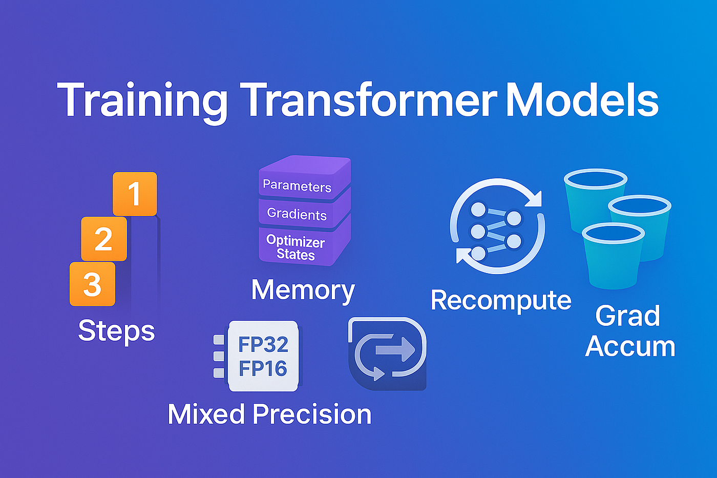
Train / Test Split: 80/20
Hyperparameters:
Epochs: 5
Batch Size: 2
Gradient Accumulation: 4 steps
Effective Batch Size: 8
Training
Fine-tuned model parameters.
GPT-2 uses cross-entropy loss
Evaluated after each epoch

Slide 7
Evaluation Metrics
Accuracy: Percentage of reviews where the predicted stars exactly match the actual stars
Error Analysis: Reviews categorized by prediction error:
Perfect: Error = 0
Close: Error = 1
Bad: Error = 2
Awful ≥ 3
Accuracy: 65.2%
Not a fair metric
!

Slide 8
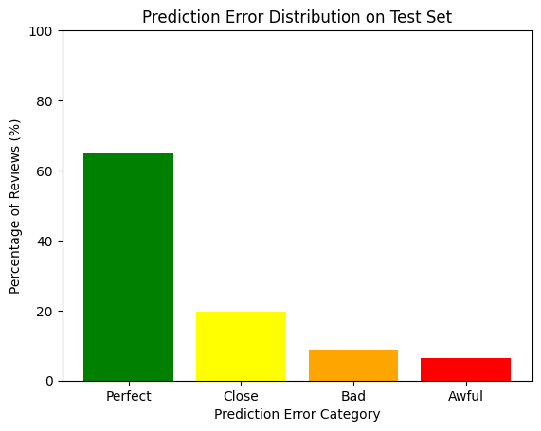
Results: Error Distribution
Most predictions are Perfect or Close
Fewer predictions are Bad or Awful
Model performs reasonably well, but some challenging reviews remain

Slide 9
Example Predictions
=== Random Review ===
Text: Easy A+, there's not a lot of work in this class, just remember that you actually have homework due around every week.
Some of the later ones can get conceptually tougher (esp if you aren't a CS major) but you always have OH.
This is basically an entire async class where you will never have contact with anyone. Just self paced homework. Pretty simple GPA booster
Actual: 5
Predicted: 5

Slide 10
Example Predictions
=== Awful Review ===
Text: This is my first time ever writing a review, but DO NOT TAKE HIS CLASS. You will find out midterm topics a week before the exam, if he even tells you when they are. Get ready to just learn through super old videos, but if you can manage learning through just those you should be okay. But no he's actually the worst so avoid at all costs.
Actual: 1
Predicted: 5

Slide 11
Limitations and Challenges
Small Dataset: Limited number of reviews to train the model
Imbalanced Ratings: Most reviews are 5-star. Lower ratings are underrepresented
Long Reviews: Longer or nuanced reviews may confuse the model
Sarcasm and Ambiguity: Model struggles with sarcastic, vague, or highly subjective language
?
How would the model change if the dataset was bigger? More balanced?

Slide 12
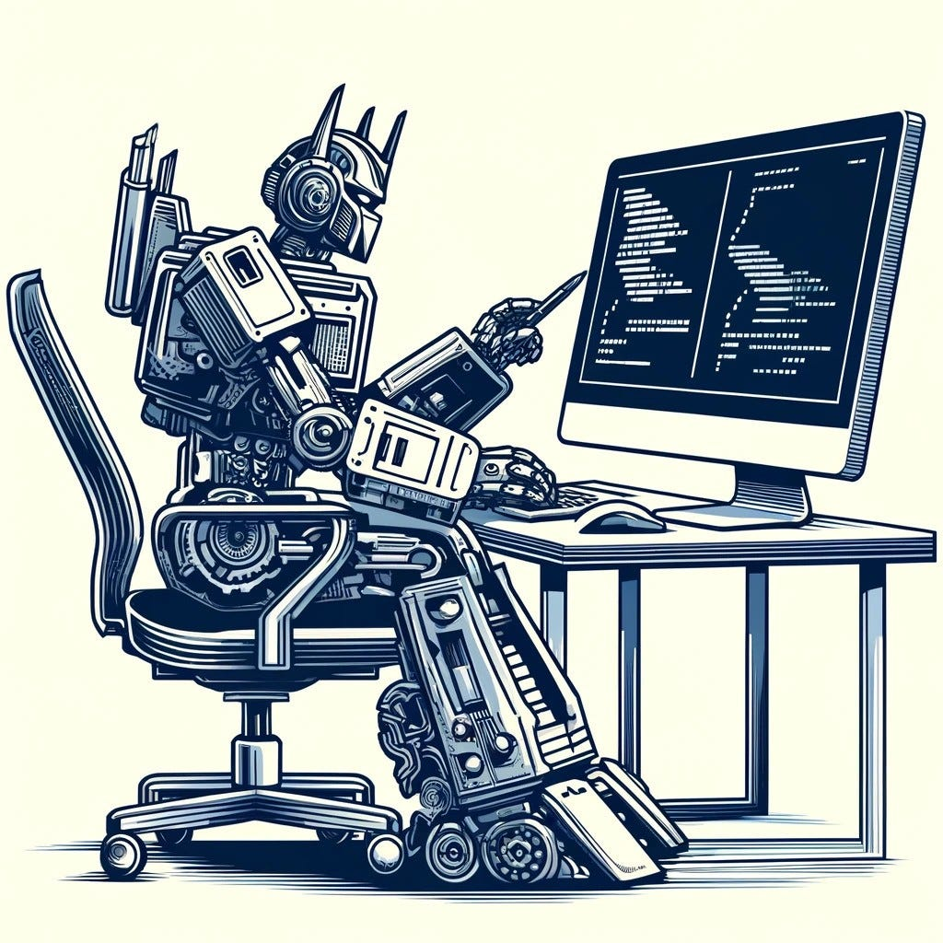
Conclusion
Successfully fine-tuned GPT-2 on professor reviews to predict ratings.
Transformer achieved reasonable accuracy with most predictions either exact or within 1 star of actual.
Main limitations: small dataset and imbalanced ratings, which impact accurate evaluation of model performance.

